Slide 1



RadioMap Prefetching for Indoor Navigation in Intermittently Connected Wi-Fi Networks
Andreas Konstantinidis∗, George Nikolaides∗, Georgios Chatzimilioudis∗, Giannis Evagorou‡, Demetrios Zeinalipour-Yazti∗ and Panos K. Chrysanthis§
∗Department of Computer Science, University of Cyprus, 1678 Nicosia, Cyprus
‡Department of Computing, Imperial College London, SW7 2AZ London, UK
§Department of Computer Science, University of Pittsburgh, PA 15260, USA
16th IEEE Int. Conference on Mobile Data Management (MDM’15), Pittsburgh, PA, USA, June 16, 2015

Slide 2

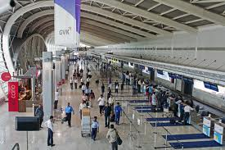




Motivation
People spend 80-90% of their time indoors – USA Environmental Protection Agency 2011.
>85% of data and 70% of voice traffic originates from within buildings – Nokia 2012.

Slide 3
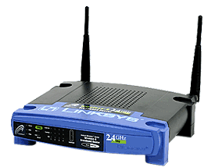


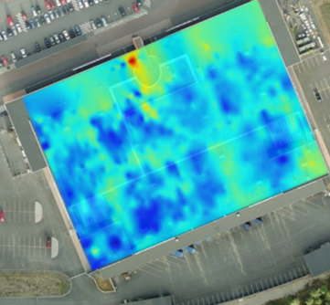
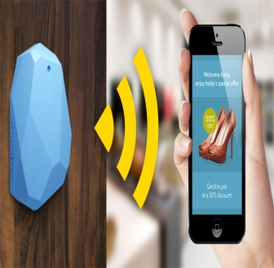

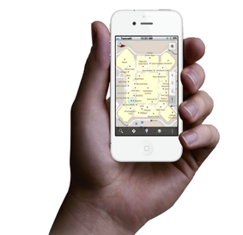
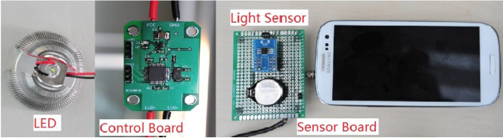
Localization Technologies
Modern trend is to build Internet-based Indoor Navigation (IIN) services founded on measurements collected by smart devices.
Technologies:
Wi-Fi APs, Cellular Towers, other stationary antennas
IMU Data (Gyroscope, Accelerometers, Digital Compass)
Magnetic Field Sensors
Beacons (BLE Beacons, RFID Active & Passive Beacons)
Sound (Microphone), Light (Light Sensor), …

Slide 4
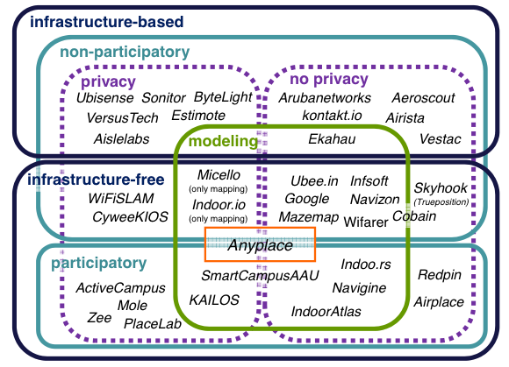
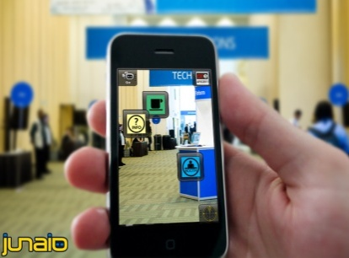
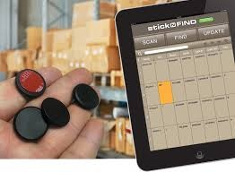
Indoor Applications
Huge spectrum of indoor apps
Augmented Reality
Healthcare, Smart Houses , Elderly support , Fitness apps
Manufacturing, Asset Tracking and Inventory Management
Indoor Revenues expected reach 10B USD in 2020
ABIresearch, “Retail Indoor Location Market Breaks US$10 Billion in 2020”’ Available at: https://goo.gl/ehPRMn, May 12, 2015.
Don’t miss the Tutorial!
“Mobile Data Management in Indoor Spaces”, Christos Laoudias and Demetrios Zeinalipour-Yazti
Wed. Jun 17, 11:00-12:30, Ballroom 3
Academic & Industrial Development
Background, State-of-the-Art, Challenges

Slide 5

Anyplace IIN Service
Anyplace: A complete IIN Service open for research and development
Accuracy (1.96m [IPSN15])
Crowdsourcing [IC12]
Privacy [TKDE15], Openness [MDM12]
Other: Modeling, Modular, …
Model Your Building!
It takes 1 minute to get your model online – 1 hour to offer indoor navigation and search in a 2500 sq meter building!
Don’t miss our Demos!
Anyplace: A Crowdsourced Indoor Information Service , Kyriakos Georgiou Timotheos Constambeys, Christos Laoudias, Lambros Petrou, Georgios Chatzimilioudis and Demetrios Zeinalipour-Yazti
Tuesday, Jun 16, 15:30-17:00, Sterlings
Thursday, Jun 18, 13:30-15:00, Sterlings
http://anyplace.cs.ucy.ac.cy/

Slide 6
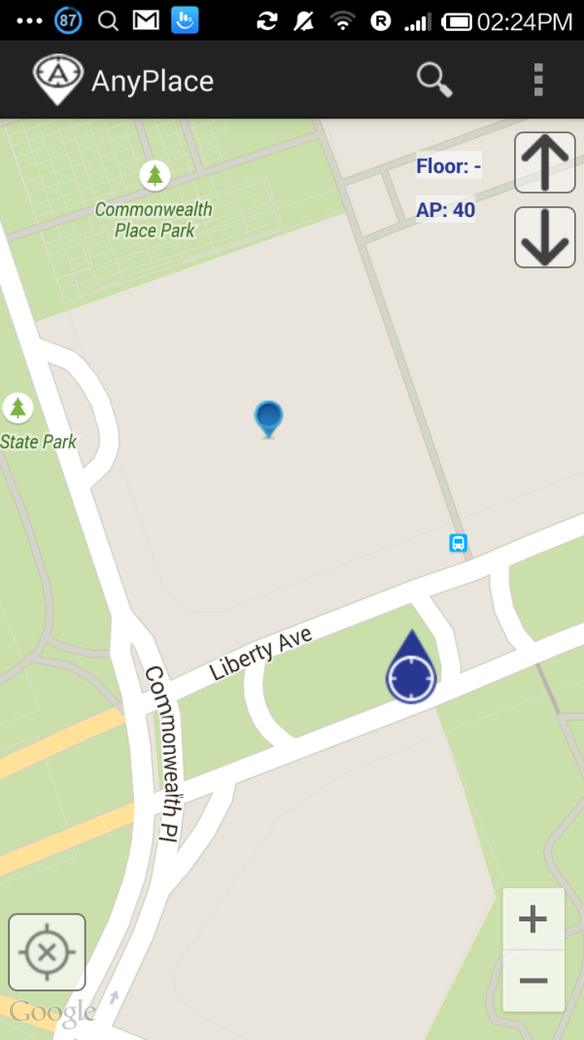
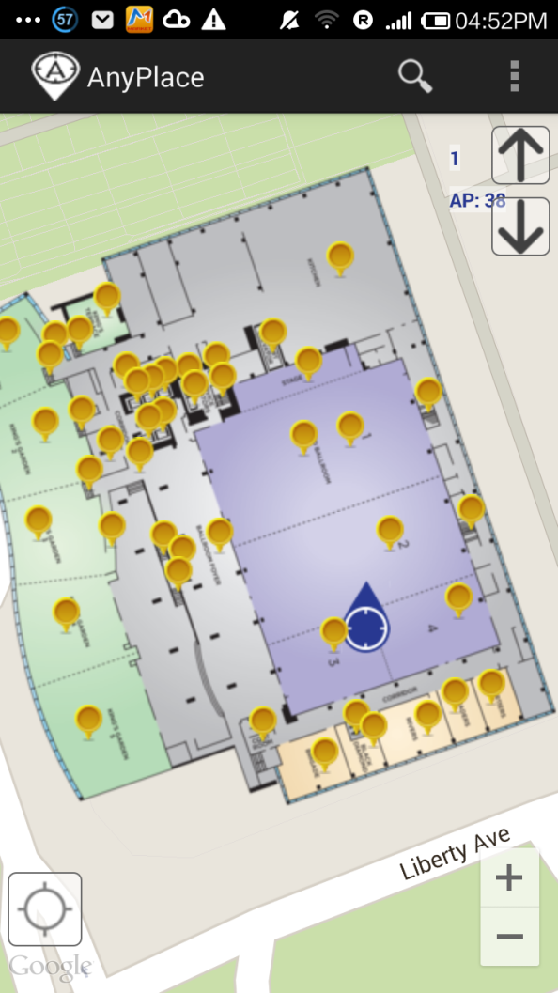
Anyplace @ MDM’15
After ☺
(using Anyplace Location & Indoor Models)
Before ☹
(using Default Location)

Slide 7
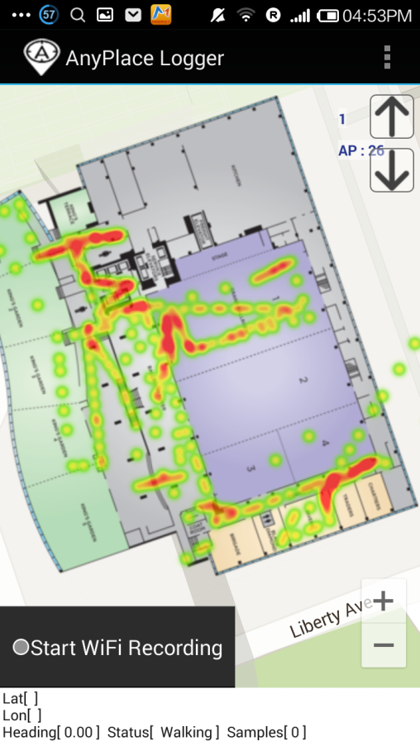
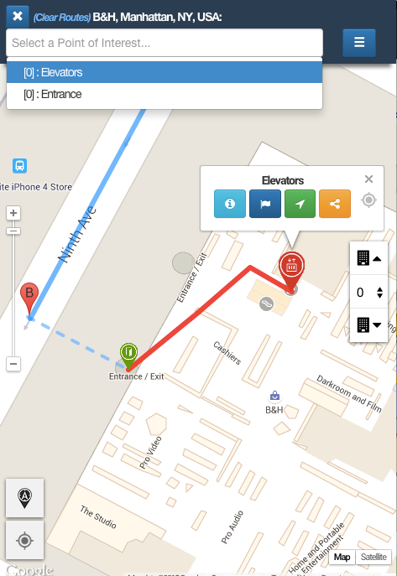
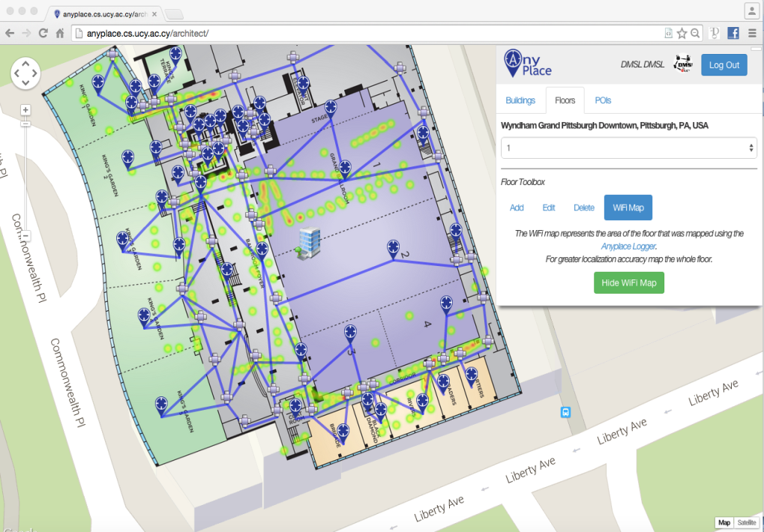
Anyplace @ MDM’15
Model: 1 hour (Image & POIs)
Radiomap: 10 minutes / floor
Could also use Google Indoor Maps (NOT frequently available and also NO fine location available! )

Slide 8
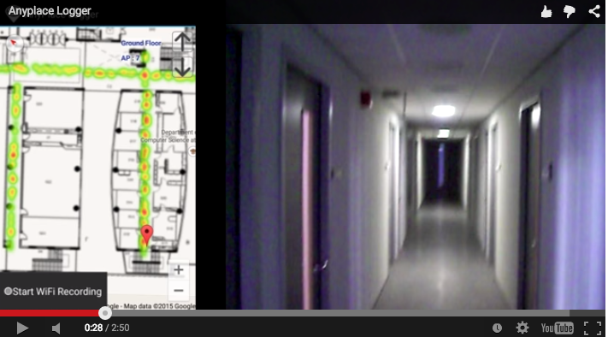
Logging in Anyplace
Video

Slide 9
Presentation Outline
Introduction
Problem Formulation
The PreLoc Framework
Partitioning Step
Selection Step
Localization Step
Experimental Evaluation
Conclusions & Future Work

Slide 10
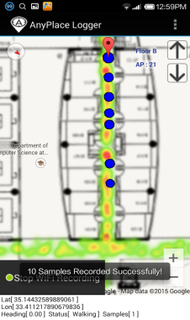
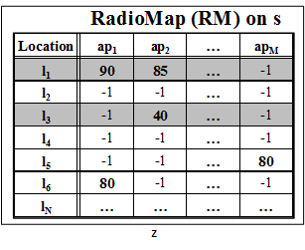
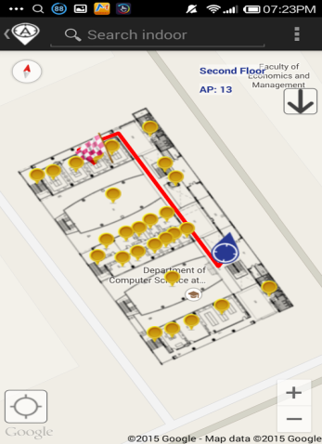
IIN Workflow
Logger
IIN Service
a) Upload Measurements
b) Build RM (Radiomap)
c) Localize
fingerprint
SSA
Navigator
d) Localization Alternatives:
Client-Side-Approach (CSA)
Server-Side-Approach (SSA)
CSA

Slide 11
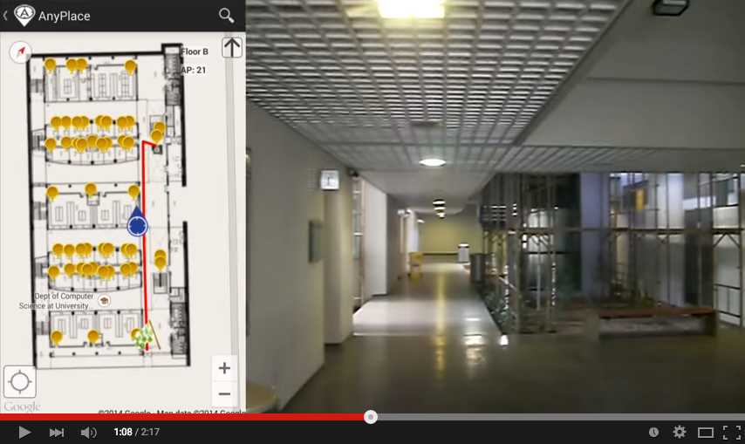
CSA Navigation (Anyplace)
Video

Slide 12
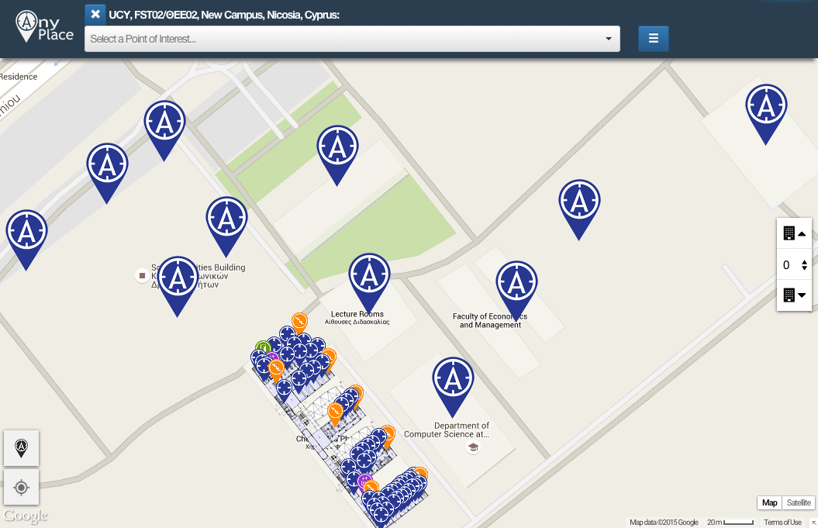
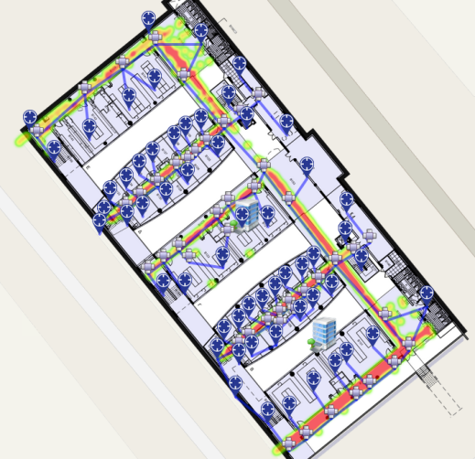
CSA Weaknesses
Don’t know a priori what buildings we need!
e.g., a user lost on a complex University Campus.
CSA not compatible with the Cloud trend!
signals, indoor POIs are overwhelming for mobiles
CSA is operating on outdated data!
Doesn’t take advantage of latest Radiomaps
Our 8,900 m² CS building has 45,000 reference positions!
(3-6MB)
Whole Campus
50-100MB

Slide 13

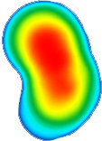
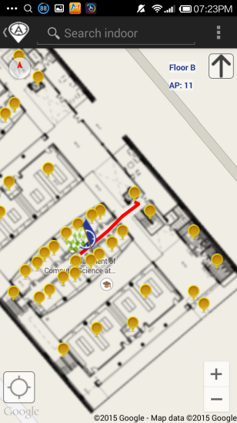
SSA Navigation (Anyplace)
IIN Service
Where-am-I?
No Navigation
Where-am-I?
X
Where-am-I?
☹ Intermittent Connectivity
Time

Slide 14
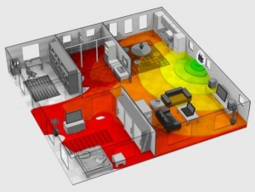
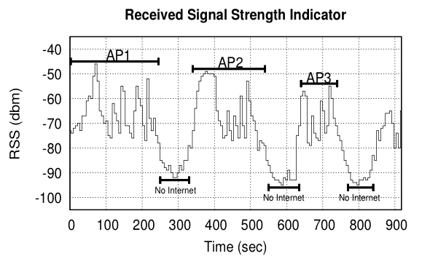
Intermittent Connectivity
Wi-Fi coverage might be irregularly available inside buildings due to poor WLAN planning
Complete planning would require a site
survey tool (e.g., Ekahau, Tamograph).
A user walking inside a Mall in Cyprus
Whenever the user enters a store the RSSI indicator falls below a connectivity threshold -85dBm. (-30dbM to -90dbM)
When disconnected SSA doesn’t offer navigation anymore ☹

Slide 15
Intermittent Connectivity
Why not fallback from Wi-Fi to Mobile Internet (2G-4G) when Wi-Fi is not available?
Mobile Internet Limitations:
Coverage: blockage or attenuation of signals in indoor spaces.
Slow fallback between outdated Mobile Internet and Wi-Fi infrastructures.
Lack of ubiquitous 802.11k, 802.11r (fast roaming) and 4G infrastructure.
Limited Quota: Nobody ones to waste a mobile Internet plan for navigation purposes.
Unavailability due to Roaming: when traveling and needing indoor navigation at most.

Slide 16
PreLoc Navigation
IIN Service
Prefetch K RM rows
Prefetch K RM rows
X
Localize from Cache
Prefetch K RM rows
☺ Intermittent Connectivity
Time

Slide 17
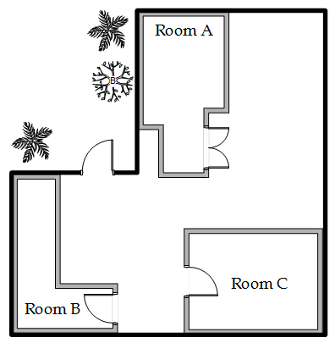




Problem Formulation
A mobile user u moves inside a building with m Access Points AP = {ap₁,…, ap_{m}}.
RadioMap (RM) is available on Server (s)
u obtains fingerprint: V_{r} = [ap_{1r},…, ap_{mr}] on every location (l), sends V_{r} to s.
P_{l}: connectivity probability of a user at location l.
Objective:
Prefetch K RM entries on u, so that u localizes accurately and efficiently (cpu time).
x
x
x
x
x
V₆
x
x
x
x
x
V₁
ap₁
x
x
x
x
V₂
V₅
x
x
x
V₄
x
x
x
x
x
x
x
x
x
x
V₃
ap₃
x
x
x
x
x
ap₄
x
x
x
x
x
x
x
x
x
x
x
ap₂
x

Slide 18
Presentation Outline
Introduction
Problem Formulation
The PreLoc Framework
Partitioning Step
Selection Step
Localization Step
Experimental Evaluation
Conclusions & Future Work

Slide 19
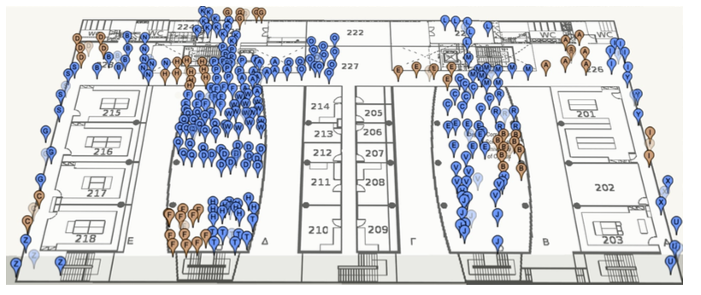
PreLoc Partitioning Step
Why? RM might contain many points (45K in CSUCY!).
Action: The objective of this step is to cluster these into groups so that they are easier to prefetch.
K-Means simple well-established clustering algorithm.
Operation: Random Centroids (C), Add to Closest C, Re-adjust C
Re-adjusting Centroids expensive quadratic complexity ☹

Slide 20
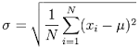
PreLoc Partitioning Step
We use the Bradley-Fayyad-Reina (BFR)* algorithm
A variant of k-means designated for large datasets.
Instead of computing L₂ distance of point p against centroid, as in k-means, it computes the Mahalanobis distance (dist_{Mah}) against some set statistics (μ, σ).
In BFR if dist_{Mah} is less than a threshold add to set, else retain to possibly shape new clusters.
Advantage: Less centroid computations! Points are traversed only once which is fast for big data!
μ
dist_{Mah}
σ
Point (p)
Scaling Clustering Algorithms to Large Databases.. PS Bradley, UM Fayyad, C Reina - KDD, 1998

Slide 21
PreLoc Selection Step
The Selection Step aims to sequence the retrieval of clusters, such that the most important clusters are downloaded first.
Question: Which clusters should a user download at a certain position if Wi-Fi not available next?
PreLoc prioritizes the download of RM entries using historic traces of user inside the building !!!
User Current Location

Slide 22
PreLoc Selection Step
PreLoc relies on the Probabilistic Group Selection (PGS) Heuristic to determine the RM entries to prefetch next.
Probabilistic k=3 Group Selection
Historic Traces
Dependency Graph
(DG)
Do Best First Search Traversal of DG from A:
follow the most promising option using priority queue.
P(A,B)=1.0
P(A,B,D)=0.66
P(A,B,D,C)=0.66*0.5=0.33
P(A,B,D,A) => cycle
P(A,B,D,C,D)=> cycle
P(A,B,C)=0.33
Empty queue – finished!
User Current Location
A
B
D
0.5
0.5
1.0
C
A
0.66
C
D
1.0
0.33
B
Early stop!
(statistically independent transitions between vertices + no stationary transitions in historic traces)

Slide 23
PreLoc Selection Step
Instead of the PGS Heuristic Search, we could have used other Blind Search techniques:
BFS, DFS, Random Walker, etc.
Random Selection (RS),
Iterative Deepening Selection (IDS)
DFS down depth W (lookahead window), then down to depth W+1,.. So essentially BFS traversal but with improved memory as we don’t need to maintain the traversal queue.
User Current Location

Slide 24
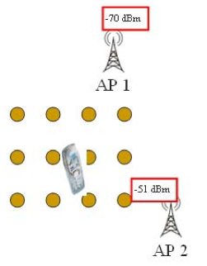
PreLoc Localization Step
User collects fingerprint V_{r} = [ ap₁, ap₂, …, ap_{m} ] and compares it to the Radiomap RM = {V₁, V₂, …,V_{n}}
Following alternatives for || V_{i} - V_{r} || computation:
Nearest Neighbor (NN)
K Nearest Neighbors (w_{i} = 1 / K) – convex combination of k locations.
Weighted K Nearest Neighbors (w_{i} = 1 / || V_{i} - V_{r} || )
RadioMap
?
V_{r} = [ -70, -51]
V₁ = [ -71, -82, (x₁,y₁)]
V₂ = [ -65, -80, (x₂,y₂)]
…
V_{N} = [ -73, -44, (x_{N},y_{N})]
User Current Location

Slide 25
Presentation Outline
Introduction
Problem Formulation
The PreLoc Framework
Partitioning Step
Selection Step
Localization Step
Experimental Evaluation
Conclusions & Future Work

Slide 26
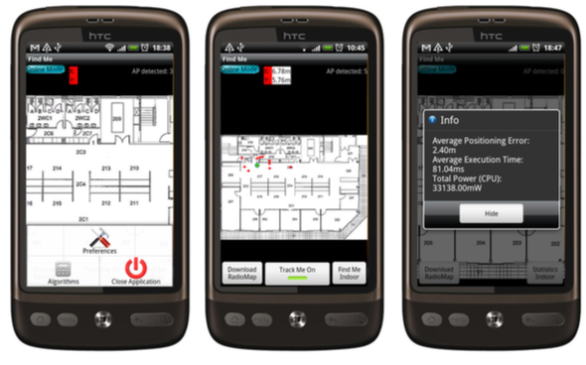
Datasets & Scenario
CSUCY Dataset
8,900 m² CS building with 4 floors (2,224 m² / floor)
120 Wi-Fi Access Points (CS, adhoc and neighboring)
|RM|=45,000 fingerprints on 2,900 locations.
Optimized RM size is 2.6MB (initial much larger).
Scenario: realistic user routes inside the building.
The localization requests are 5 meters apart
We repeat the requests 15-30 times (i.e., a user moves 50-150 meters inside the building).
Platform: Airplace
(IEEE MDM’12) - open source
Notes:
Initial fingerprints were averaged (normalized) at a 2x2m cell granularity.

Slide 27
Evaluation Metrics
Algorithms
Client Side Approach (CSA) b: building f: floor
PreLoc (PGS, IDS, RS)
Server Side Approach (SSA)
Metrics
Point Accuracy (A_{r}): L₂ distance between the estimated (λ^{u}) and the actual (l^{u}) location of u (in SSA). i.e., ||λ^{u} - l^{u}||
CPU Time (T_{r}): processing time used on u’s device for localizing given request r

Slide 28
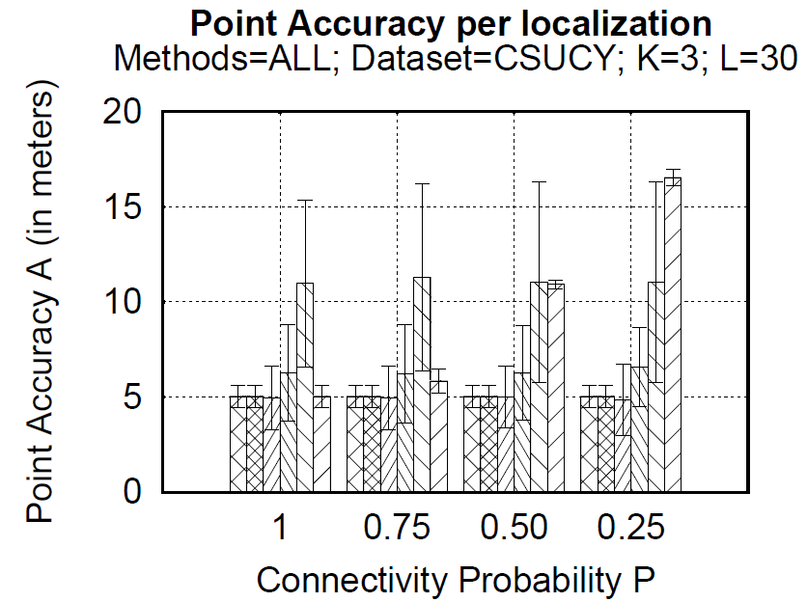
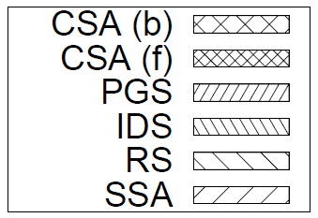
Techniques: Localization Accuracy (A)
Remarks
CSA: good accuracy (as RM is already local) – 5 meters (Airplace)
SSA accuracy severely affected by failures – 17 meters for P=0.25.
PreLoc (PGS, IDS) sometimes better accuracy than CSA!
PreLoc (RS) has high standard deviation due to randomness

Slide 29
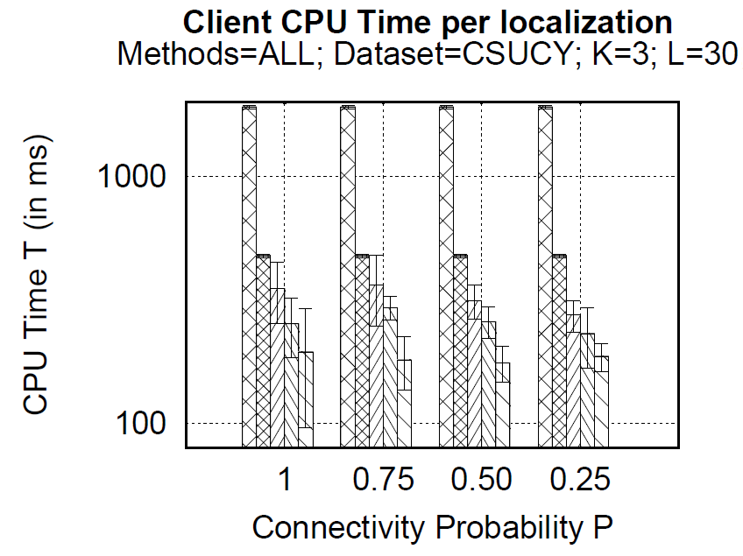
Techniques: CPU Time (T)
(BFR Partitions)
Remarks
CSA(b): worse time 1911ms (needs to compare V_{r} vs. complete RM)
CSA(f): still bad time 520ms (graph is log-scale!)
SSA best CPU time 2.6ms but is not accurate under failures P<1
PreLoc (PGS, IDS) 274, 230ms milliseconds for execution!!

Slide 30
Presentation Outline
Introduction
Problem Formulation
The PreLoc Framework
Partitioning Step
Selection Step
Localization Step
Experimental Evaluation
Conclusions & Future Work

Slide 31
Conclusions & Future Work
PreLoc is a new framework for carrying out hybrid Client/Server localization in intermittently connected Wi-Fi networks.
Our experimental evaluation shows that historic traces can indeed serve as vehicle to predict future movements.
In the future, we aim to:
Devise alternative prefetching algorithms.
Carry out a more rigorous analytical and experimental study.
Study Anyplace Integration Issues.

Slide 32
RadioMap Prefetching for Indoor Navigation in Intermittently Connected Wi-Fi Networks
Andreas Konstantinidis, George Nikolaides, Georgios Chatzimilioudis, Giannis Evagorou, Demetrios Zeinalipour-Yazti and Panos K. Chrysanthis
Thank You!
Questions?
Contact: dzeina@cs.ucy.ac.cy
16th IEEE Int. Conference on Mobile Data Management (MDM’15), Pittsburgh, PA, USA, June 16, 2015

Slide 33
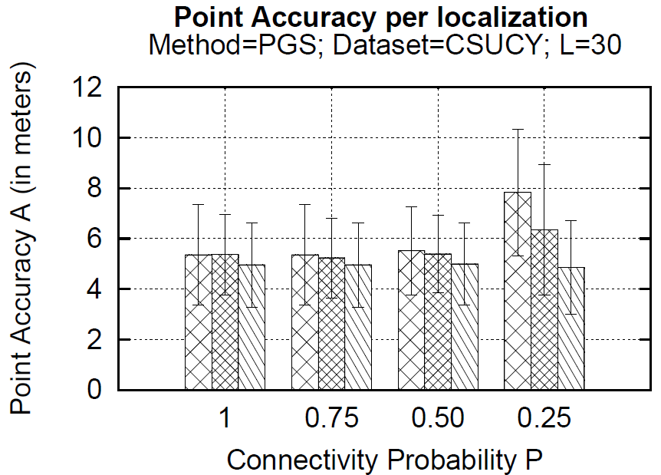
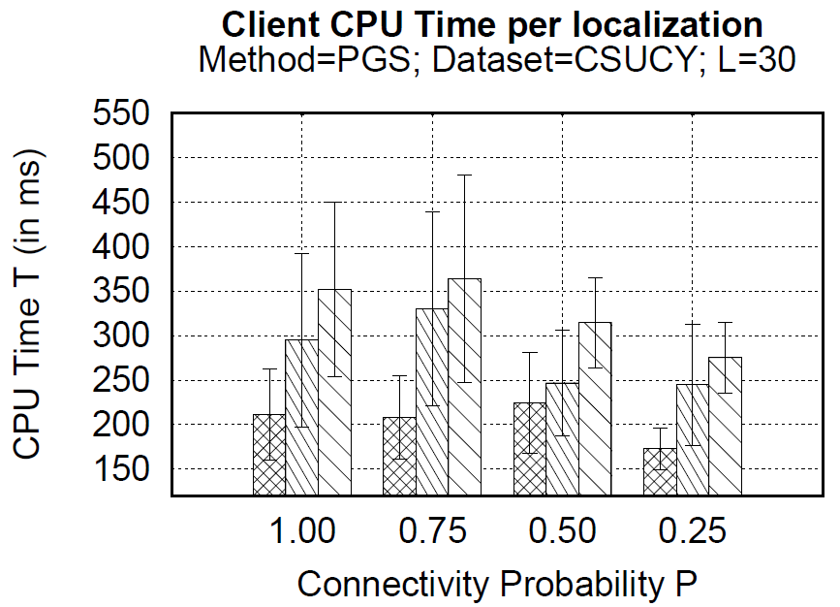
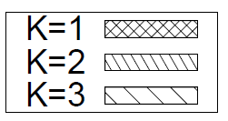
Varying Number of Prefetched Clusters
K is the number of clusters prefetched (look ahead window)
Results only for PGS
A: Under no disconnections => same accuracy for K=1, 2 and 3.
A: With P=0.25 having a larger look-ahead window (K=3) is good
T: Larger look-ahead window => slight increase in CPU time
T: More failures => client processes less (for all K values)

